Slide 1

DETECTING AND PREDICTING EVIDENCES OF INSIDER TRADING IN THE BRAZILIAN MARKET
Felipe Lauar
Cristiano Arbex
Universidade Federal de Minas Gerais
PRESENTATION BIG DATA ANALYTICS A.A. 2020/21
FRANCESCO SALERNO

Slide 2

INSIDER TRADING
Insider Trading refer to negotiations of securities of a public company by individual with access to related non public informations.
Increase the overall risk and reduce the participation in the market
If not respect the legal requirement it is a crime
2

Slide 3
WHY BRAZILIAN MARKET?
US MARKET
SEC (SECURITIES AND EXCHENGE COMMISSION)
BRAZILIAN MARKET
CVM ( BRAZILIAN REGULATORY AGENCY)
IN 2017 AND 2018 UP TO 100 CASES IDENTIFIED
UP TO 2019 VERY FEW CASES HAVE BEEN PERSECUTED
3

Slide 4
PROBLEMS TO SOLVE
A
IDENTYFING A SET OF RELEVANT DAYS WITH IMPORTANT NEWS
CREATING A DATASET
1
B
IDENTYFING POSSIBLE ABNORMAL NEGOTIANTIONS
CLASSIFYING POSSIBILE INSIDER TRADING ACTIONS
2
BOTH STOCKS AND OPTIONS MARKET
4

Slide 5
Manually build the 2017 dataset
Deriving 2018 Dataset
XGBOOST
52%
training
48%
validation
100%
Test
Recognising souspicious trades before an event unfold
5

Slide 6
POSSIBLE BENEFITS
1
CAN HELP MUTUAL FUND TO REDUCE THE OVERALL RISK BEFORE AN “IMPACTFUL” EVENT
2
CAN HELP RELUGATORY AGENCY TO ANTICYPATING CRIMES
6

Slide 7
FEATURES CREATED
2017 DATASET CREATION
A
IDENTYFING A SET OF RELEVANT DAYS WITH IMPORTANT NEWS
B
IDENTYFING POSSIBLE ABNORMAL NEGOTIANTIONS
EXTREME DAYS RETURN
DAYS WTH RELEVANT EVENTS
STOCK MARKET
1.LARGEST NEGOTIATIONS
2. LARGEST VOLUME TRADED IN EACH MILLISECOND
3.SUM SHARES TRADED IN ALL NEGOTIATIONS > TRASHOLD
54 STOCKS
11988 DAYS
OPTIONS MARKET
4.SUM CALL OPTIONS
5.SUM OF PUT OPTIONS
6.LARGEST CALL OPTIONS TRADED
7. LARGEST PUT OPTIONS TRADED
8. DIFFERENCES BETWEEN 4 AND 5
9.DIFFERENCE BETWEEN 6 AND 7
GOOD 84
BAD 87
NO 1187
7
DAYS
GOOD EVENTS (84 DAYS)
BAD EVENTS (87)
NO EVENTS (11817)

Slide 8
EACH STOCK HAS DIFFERENT INTRADAY VOLUMES AND LIQUIDITY PATTERN WHEN IT IS TRADED
IN FACT DATA HAVE BEEN NORMALISED USING CUMULATIVE DISTRIBUTION FUNCTION
ABNORMAL CLASSIFICATION RULES:
1 THEY HAPPEN 20 DAYS PREVIUOS AN EVENT UNFOLD
2.PUT OPTIONS BEFORE GOOD EVENTS AND CALL OPTIONS BEFORE BAD EVENTS
HAVE BENN REMOVED
3.OTHERS VOLATILITY AND TEMPORAL CONSTRIAN
OBTAINED
89 EVENTS OVER 171 (52%)
146 NEGOTIATIONS DAYS OVER 3098
8

Slide 9
XGBOOST EXTREME GRADIENT BOOSTING ALGORTIMHS
XGBoost is a decision-tree-based ensemble Machine Learning algorotithm that uses a gradient boosting framework
FEATURES
REGULARIZED BOOSTING AVOIDING OVERFITTING
CAN HANDLE MISSING VALUE AUTOMATICALLY
CAN CROSS VALIDATE AT EACH ITERATION
INCREMENTAL TRAINING
TREE PRUNING

Slide 10
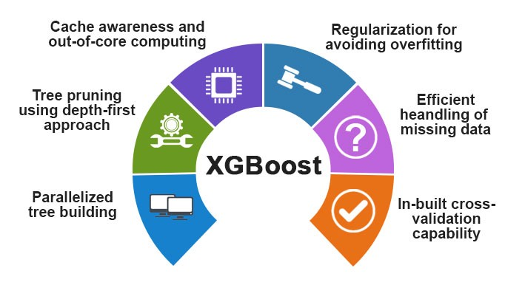
9
Image from Medium.com

Slide 11
2017 dataset
from 10/07 TRAINING
Deriving 2018 Dataset
1
XGBOOST
11/07 TO 28/12 TEST
PRECISON 32%
RECALL 87%
CLASS | 2017 | 2018 | TOTAL
GOOD EVENTS | 84 | 142 | 226
BAD EVENTS | 87 | 107 | 194
NO EVENTS | 11817 | 12981 | 24798
TOTAL | 11988 | 13230 | 25218
RESULT
PRECISON 37%
RECALL 92%
CLASS | 2017 | 2018 | TOTAL
DAYS WITH EVIDENCES | 146 | 249 | 395
DAYS WITHOUT EVIDENCES | 12922 | 12981 | 25903
TOTAL | 13068 | 13230 | 26298
EVENTS WITH INSIDER TRADING EVIDENCES | 89 | 144 | 233
EVENTS WITHOUT INSIDER TRADING EVIDENCES | 82 | 105 | 182
TOTAL | 172 | 249 | 420
RESULT
10
PREDICTED 674 DAYS TITH POSSIBLE RELEVANT NEWS.
MAUALLY CHECKING THE RESULT IS PRESENTED HERE:
PREDICTED/ACTUAL | NEGATIVE | POSITIVE
NEGATIVE | 1005 | 33
POSITIVE | 458 | 216

Slide 12

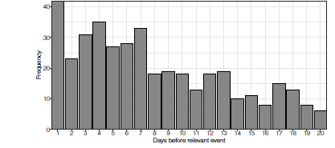
DISTRIBUTION OF POSSIBLE EVIDENCES OF INSIDER TRADING ACCORDING TO THE NUMBER OF DAYS BEFORE THE RELEVANT NEWS
11

Slide 13
2017 dataset
A.INSIDER ACTIONS
B.IMPACTFUL EVENTS
2018 dataset
2
A
PREDICTING INSIDER TRADING ACTION WITHOUT EVENTS INFORMATIONS
Regulatory agency
METRIC | TRAINING SET | VALIDATION SET | TEST SET | STRATIFIED | UNIFORM
PRECISION | 0.217 | 0.122 | 0.184 | 0.018 | 0.019
RECALL | 0.717 | 0.750 | 0.687 | 0.01 | 0.503
F1-SCORE | 0,334 | 0.211 | 0.291 | 0.013 | 0.037
F1-SCORE (R2) | 0.240 | 0.158 | 0.200 | <0.01 | 0.018
Prevent false postive
B
PREDICTING IF AN IMPACTUFUL EVENT WILL HAPPEN IN THE NEXT 20 DAYS
Risk management
METRIC | TRAINING SET | VALIDATION SET | TEST SET | STRATIFIED | UNIFORM
PRECISION | 0.666 | 0.167 | 0.245 | 0.155 | 0.149
RECALL | 0.325 | 0.628 | 0.514 | 0.137 | 1
F1-SCORE | 0,437 | 0.264 | 0.332 | 0.0146 | 0.260
F1-SCORE (P2) | 0.291 | 0.044 | 0.081 | 0.022 | 0.039
Prevent false negative
12

Slide 14
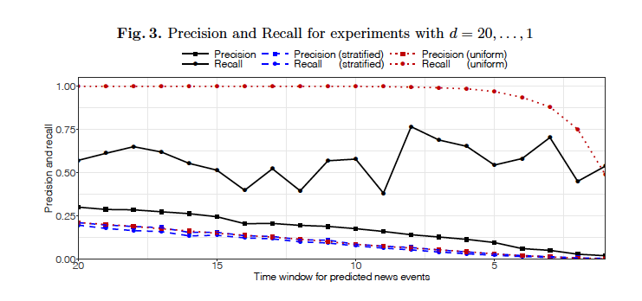
13

Slide 15

CONCLUSION EACH EVIDENCES OF POSSIBILE INSIDER TRADING ACTION DO NOT RAPRESENT A LEGAL CRIME THE AIM IS TO GIVE THE POSSIBLITY TO THE REGULTORY AGENCY TO FOCUS OVER A SMALLER GROUP OF NEGOTIATIONS IN ORDER TO IMPROVE MARKET EFFICENCY LASTLY THIS REPRESENT THE FIRST WORK PRESENT IL LITERATURE AND IT MIGHT BE USED AS PRECEDENT FOR FUTURE WORK REGARDING THE BRAZILIAN MARKET
EACH ABNORMAL NEGOTIATIONS IS A CRIME?
SO WHAT IS THE WORK

Slide 16
Conclusion – Economical Benefit
1. BEHIIND EACH ABNORMAL NEGOTIATIONS IS THERE AN INSIDER TRADER ACTION?
NO ABSOLUTELY, THEY ARE ONLY POSSIBLE ONES.
2. SO WHAT CAN REGULAGTORY AGENCY DO LOOKING AT THIS WORK?
FOCUS ON A SMALLER GROUP OF POSSIBLE EVIDENCES TO IDENTIFY CRIMES
3. WHAT ABOUT RISK MANAGEMENT WHAT CAN THEY IMPROVE USING THESE RELSULTS?
THEY CAN REDUCE EXPOSURE IF AN IMPORTANT EVENT IS COMING IN THE NEXT 20 DAYS
4. WHAT ABOUT US? WHO INVEST OR WHO WOULD LIKE TO INVEST IN THE BRAZIALIN MARKET?
WE WILL BENEFIT FROM THE IMPROVEMENT THAT THE REGULATORY AGENCY WILL APPLY IMPROVING CONTROLS
5. IS THERE ANY ASPECT THAT CAN BE IMPORVED?
YES, THIS RAPRESENT THE FIRST WORK CARRIED OUT IN THE BRAZIALINA MARKET REGARDING INSIDER TRADING AND IT WILL BE USED AS COMPARABLE RESULT FOR FUTURE WORK.
14

